Slide 1
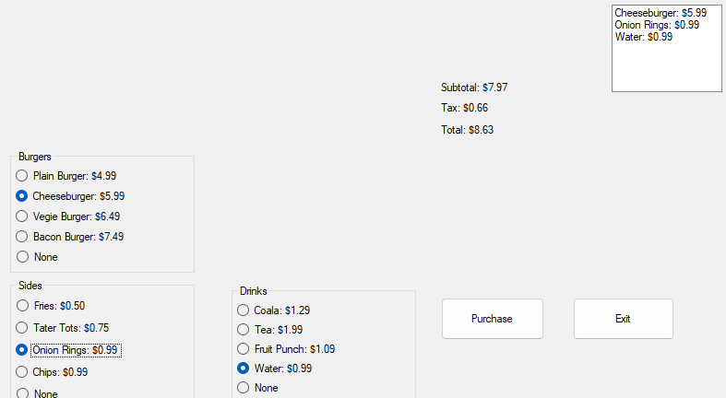
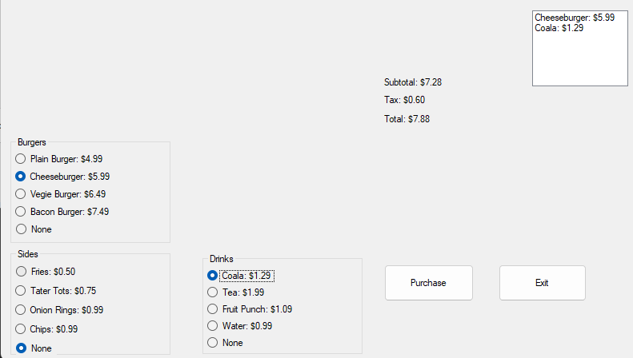
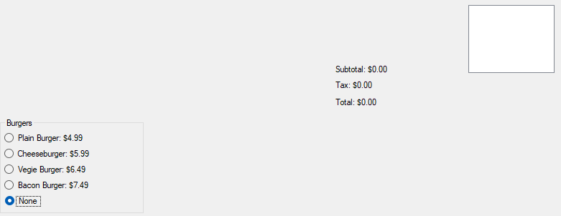
Charlie Hatch’s “Fall” Presentation- 2024
Charlie Hatch’s “Fall” Presentation- 2024
Presented to you by: Charlie Hatch
Before we start, here’s a question. how is this the fall term? I mean, Look at the weather
So, Just a second, let me fix that
There, that’s better

Slide 2
3 things I learned in core
Ways of dealing with sensory overload
No, I can’t think of them off the top of my head
More information on how your behaviour can affect being hired and promotions
Some other stuff

Slide 3
3 Things I leaned in Tech
How to make a close button which requires a confirmation period
My own invention
How to make multiple buttons be bonded to a single event
How to simplify certain parts
And find out that apparently mine was one of the most simplified ones without utilizing more complex behaviours. Best part though?
It’s modular
Highly future proof, with plans to make it better-er
Expandable to possibly make other parts smaller (albeit making it longer)

Slide 5
Things I learned in
: Club
Club
b Club
bo Club
bot Club
both Club
Club

Slide 6
